Slide 1
PREDICTING CUSTOMER CHURN IN CONNECTTEL
A Data-Driven Approach for Sustainable Growth

Slide 2
OBJECTTIVES
The ultimate goal is to empower ConnectTel to reduce customer attrition rates, enhance customer loyalty, and maintain a competitive advantage in the fast-paced and competitive telecommunications industry. By addressing the customer churn challenge through data-driven insights, our solution will contribute to ConnectTel's efforts to provide exceptional customer service, improve business outcomes, and continue revolutionizing the telecom industry.

Slide 3
ConnectTel had a total of 7,043 subscribers before some of them decided to discontinue their subscriptions for various reasons.

Slide 4
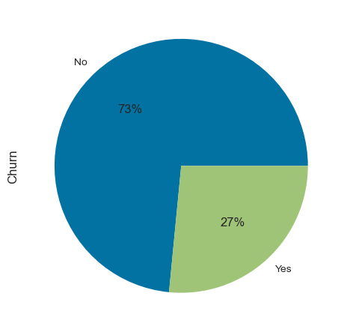
VISUALIZING CHURN DISTRIBUTION USING A COUNTPLOT
No 5174
Yes 1869
Which is about 27% for yes and 73% for No
The distribution of churn in Connecttel shows that:
"No" Churn: There are 5,174 customers who did not churn.
"Yes" Churn: There are 1,869 customers who did churn.
In terms of percentages:
Approximately 73% of the customers did not churn ("No" Churn).
Approximately 27% of the customers did churn ("Yes" Churn).
This distribution indicates that a significant majority of Connecttel customers did not churn, while a smaller proportion chose to churn.

Slide 5
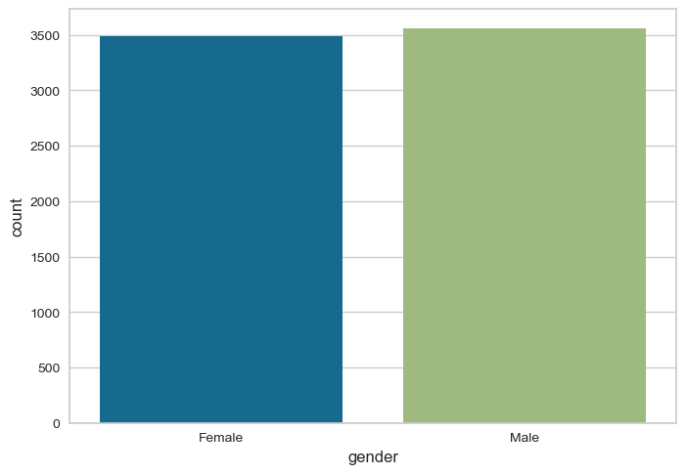
GENDER-BASED ANALYSIS
Male 3555 representing 51%
Female 3488representing 49%
Connecttel's data shows a minor gender imbalance, with 51% of customers being male and 49% female. This imbalance is unlikely to significantly impact analysis.

Slide 6
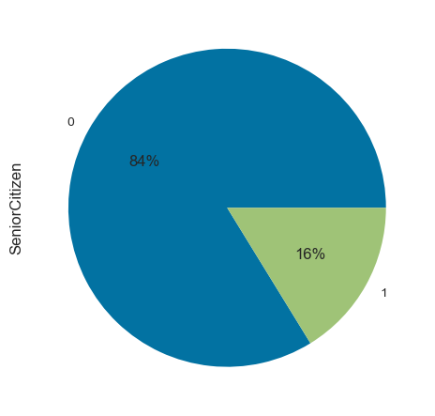
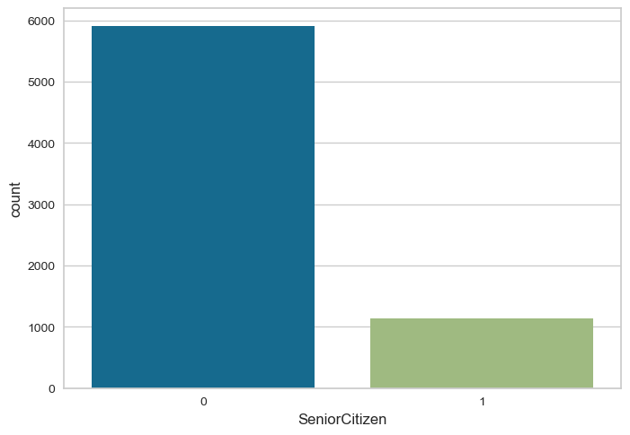
UNIVARIATE ANALYSIS OF SENIORCITIZEN
In the dataset, there are a total of 7,043 Senior Citizens.
Out of these, 1,142 Senior Citizens (approximately 16%) decided to churn (Churn = 1).
On the other hand, the majority of Senior Citizens, specifically 5,901 of them (approximately 84%), did not churn (Churn = 0).

Slide 7
The churn rate among Senior Citizens in Connecttel could be influenced by various factors;
Price Sensitivity: Senior Citizens often have fixed incomes and may be more sensitive to price increases or unexpected charges on their bills. If Connecttel raises its prices or introduces additional fees, Senior Citizens may be more likely to churn in search of more cost-effective alternatives.
Technology Adoption: Some Senior Citizens may be less technologically inclined or may not have a strong interest in the latest digital services. If Connecttel's offerings are primarily focused on advanced technology or features that Senior Citizens don't find relevant, they may churn to providers offering simpler services.
Customer Service: Senior Citizens may have higher expectations for customer service and support. If they encounter difficulties or experience poor customer service interactions, they may choose to leave Connecttel for a provider they perceive as more responsive and helpful.
Competitive Offers: Senior Citizens may be enticed by competitive offers or promotions from other telecom providers. If a competitor offers lower rates, better customer service, or additional benefits, Senior Citizens may decide to switch.
Word of Mouth: Seniors often rely on recommendations from peers and family members. Negative feedback or experiences shared by friends or family members who are Connecttel customers can influence their decision to churn.
Health and Mobility: Health issues or changes in mobility may affect a Senior Citizen's ability to use certain services effectively.

Slide 8
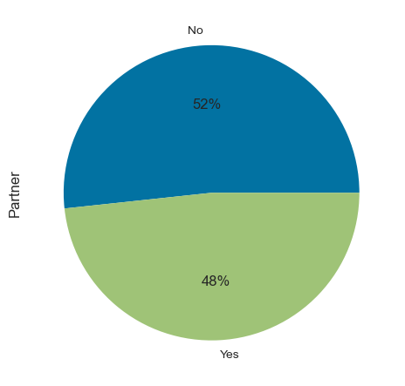
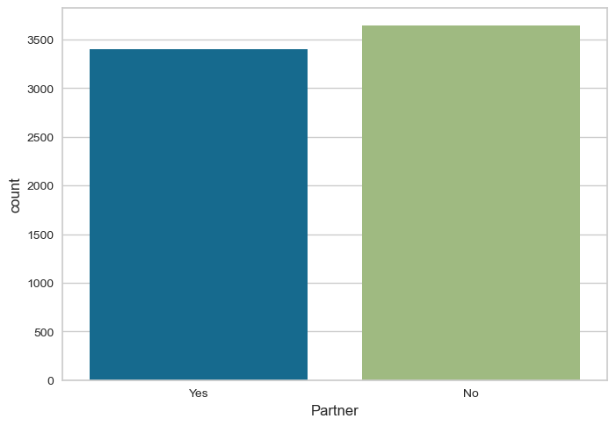
UNIVARIATE ANALYSIS OF PARTNER
There are 3,641 customers who do not have a partner, representing 52% of the total customer base.
There are 3,402 customers who have a partner, representing 48% of the total customer base.

Slide 9
This suggests that having a partner does not significantly impact the churn rate in Connecttel. Both groups, those with and without partners, have similar proportions of customers who churn and customers who do not churn.
POSSIBLE SUGGESTIONS
Communication and Education: Connecttel should communicate with customers about the value of their services, educate them about available features, and provide personalized recommendations to enhance their experience.
Retention Strategies: Develop tailored retention strategies for different customer segments. For example, offer incentives or discounts to long-term customers, improve customer support for specific service issues

Slide 10
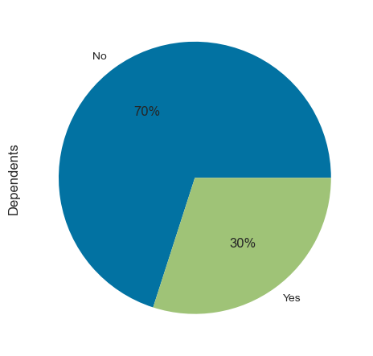
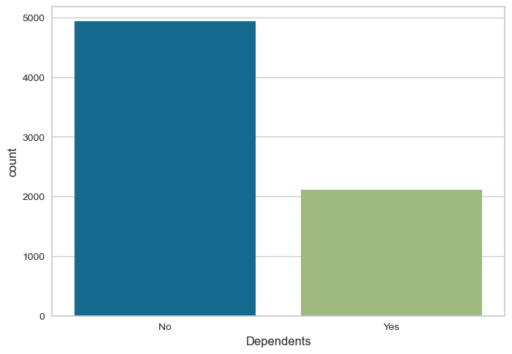
UNIVARIATE ANALYSIS OF DEPENDENTS
No 4933
Yes 2110

Slide 11
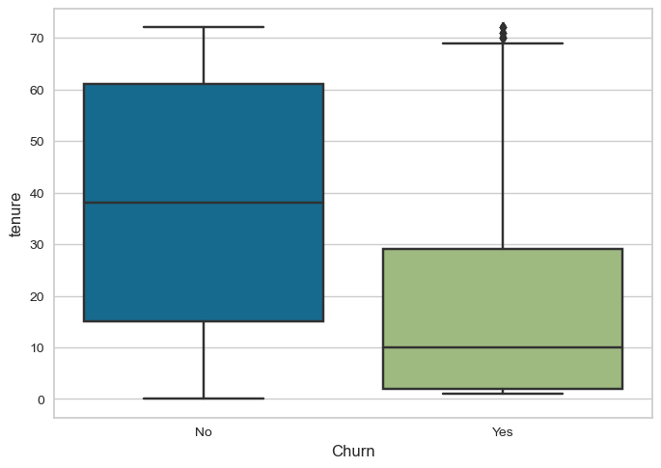
UNIVARIATE ANALYSIS OF TENURE

Slide 12
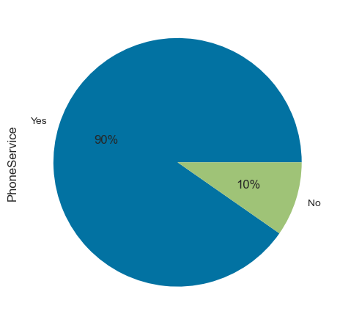
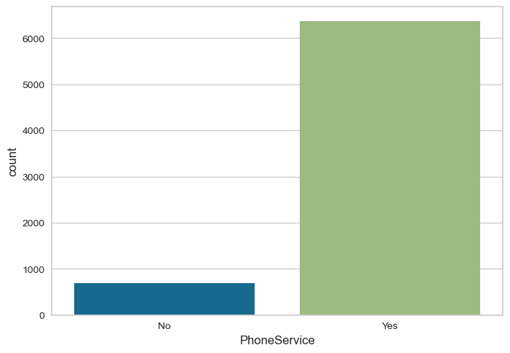
UNIVARIATE ANALYSIS OF PHONE SERVICES
Yes 6361
No 682

Slide 13
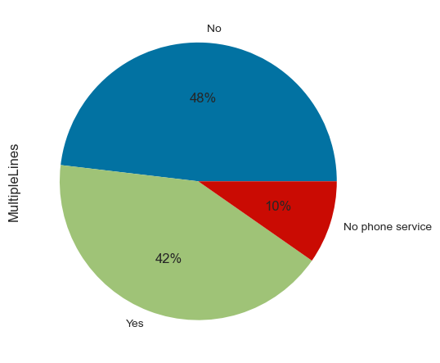
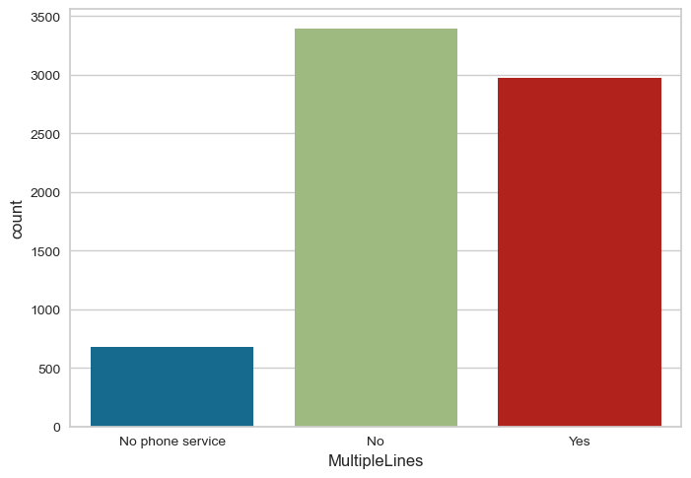
UNIVARIATE ANALYSIS OF MULTIPLELINES
Yes 6361
No 682

Slide 14
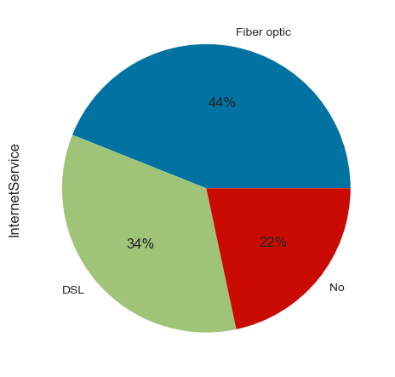
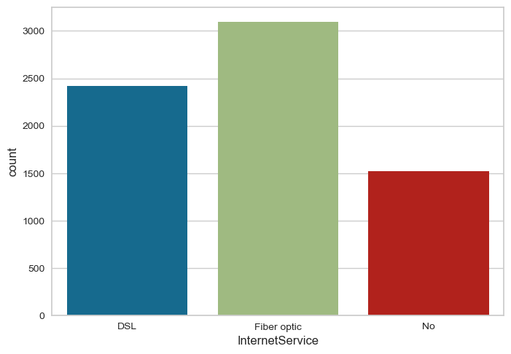
UNIVARIATE ANALYSIS OF INTERNET SERVICE
Fiber optic 3096
DSL 2421
No 1526

Slide 15
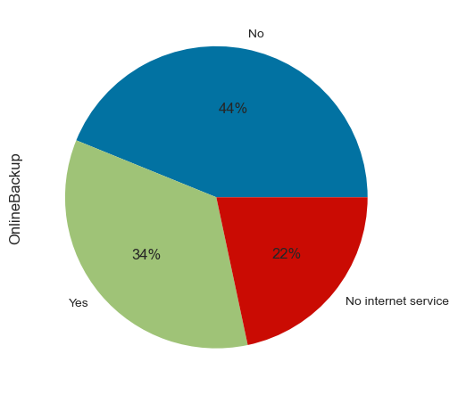
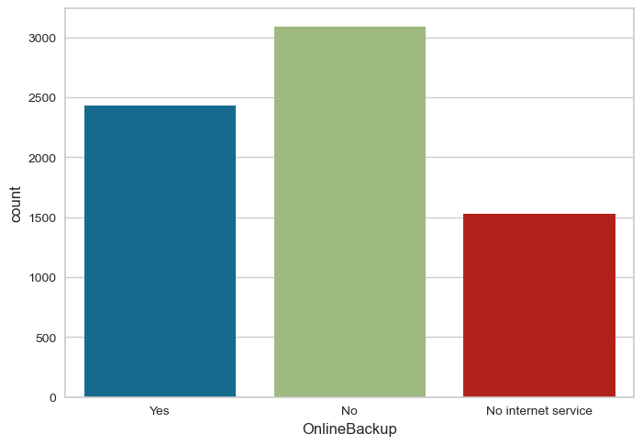
UNIVARIATE ANALYSIS OF ONLINEBACKUP
No 3088
Yes 2429
No internet service 1526

Slide 16
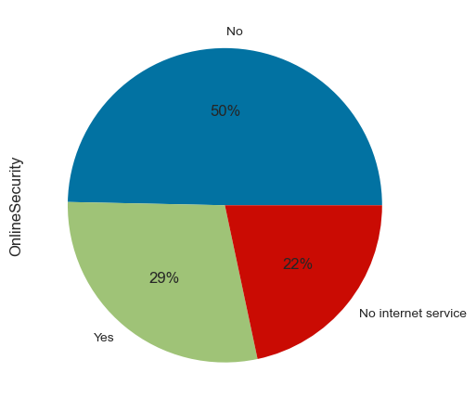
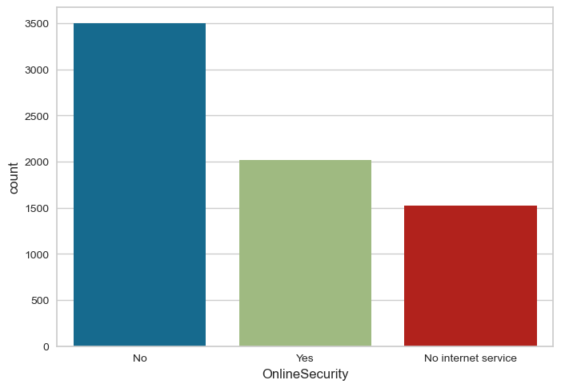
UNIVARIATE ANALYSIS OF ONLINE SECURITY
No 3498
Yes 2019
No internet service 1526

Slide 17
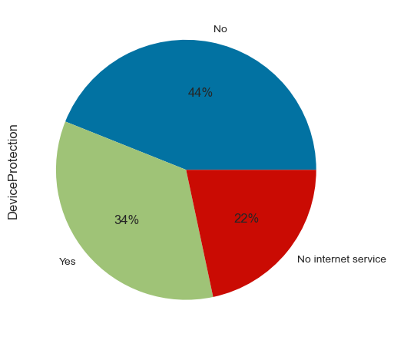
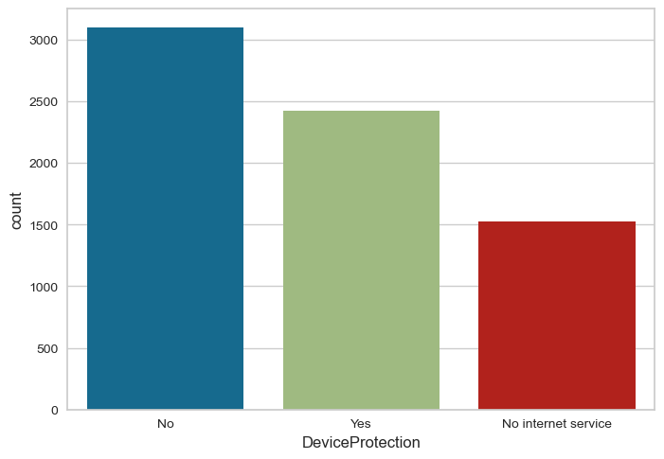
UNIVARIATE ANALYSIS OF DEVICE PROTECTION
No 3095
Yes 2422
No internet service 1526

Slide 18

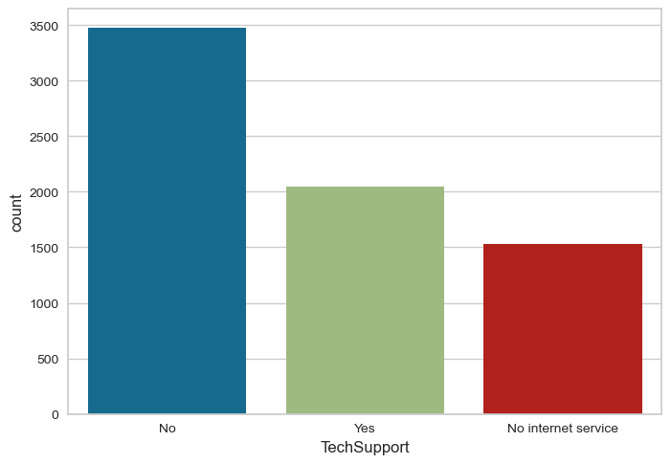
UNIVARIATE ANALYSIS OF TECH SUPPORT
No 3473
Yes 2044
No internet service 1526

Slide 19
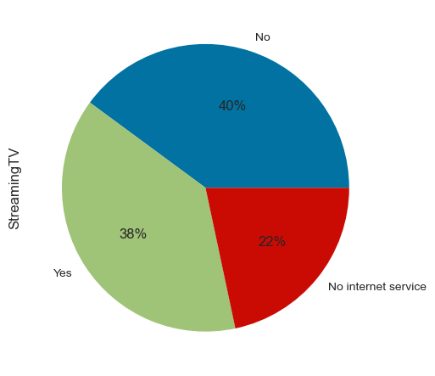
UNIVARIATE ANALYSIS OF STREAMINGTV
No 2810
Yes 2707
No internet service 1526

Slide 20

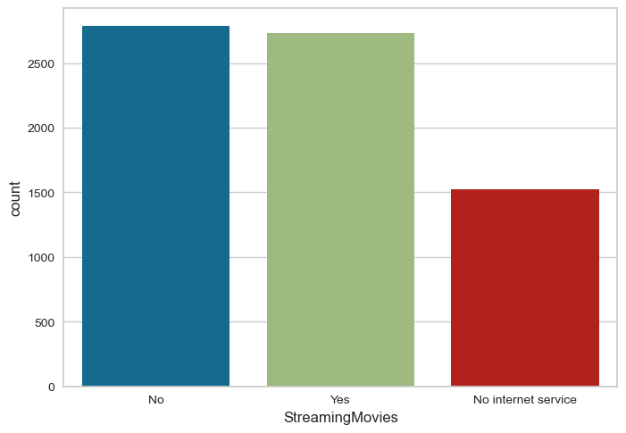
UNIVARIATE ANALYSIS OF STREAMINGMOVIES
No 2785
Yes 2732
No internet service 1526

Slide 21
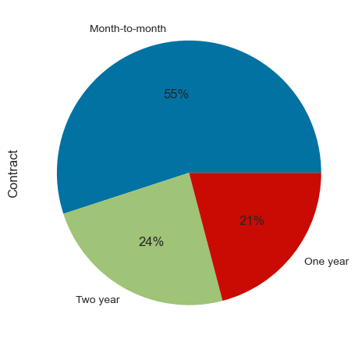
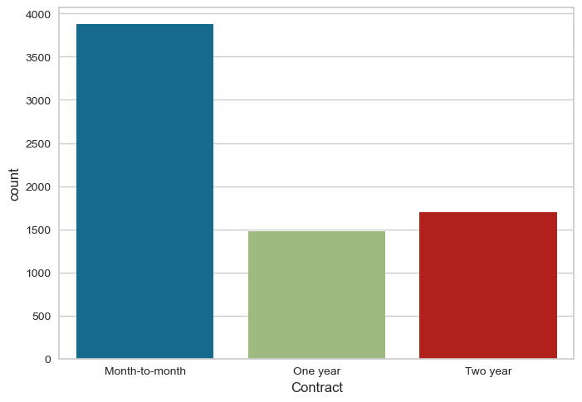
UNIVARIATE ANALYSIS OF CONTRACT
Month-to-month 3875
Two year 1695
One year 1473

Slide 22
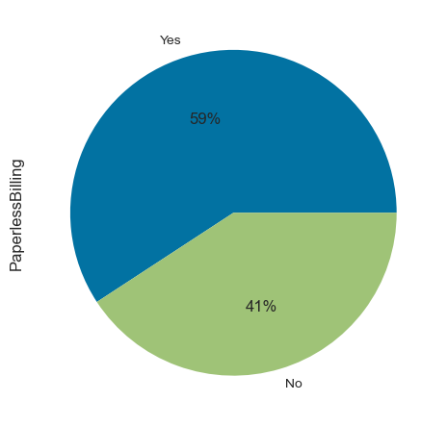
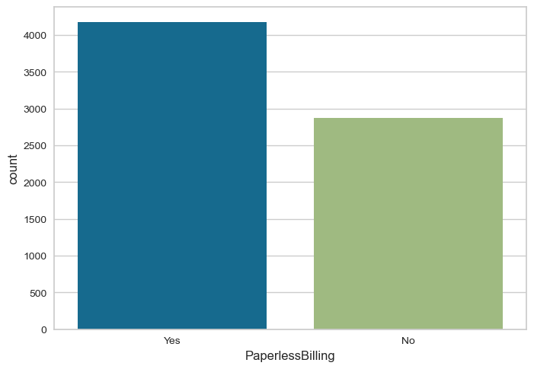
UNIVARIATE ANALYSIS OF PAPERLESSBILLING
Yes 4171
No 2872

Slide 23
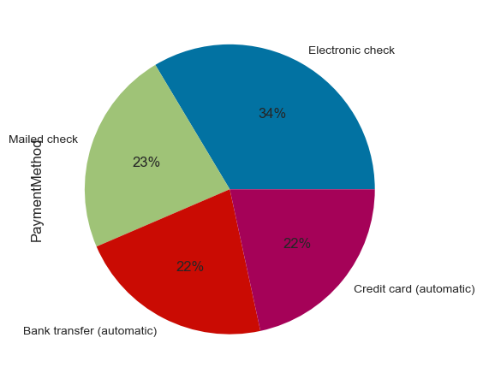
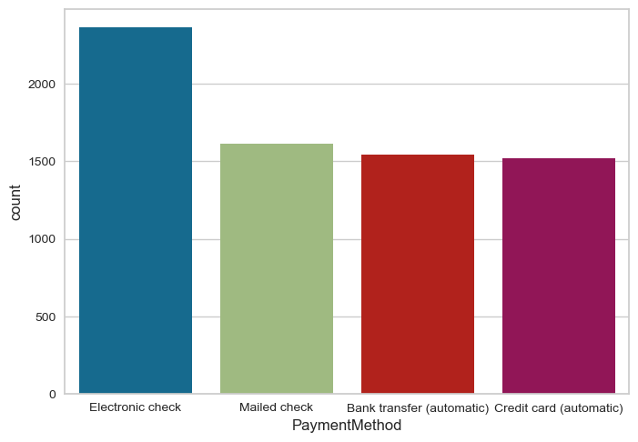
UNIVARIATE ANALYSIS OF PAYMENTMETHOD
Electronic check 2365
Mailed check 1612
Bank transfer (automatic) 1544
Credit card (automatic) 1522

Slide 24
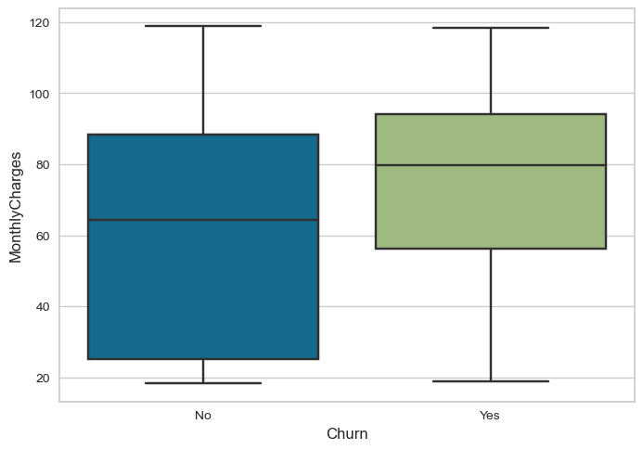
UNIVARIATE ANALYSIS OF MONTHLYCHARGES

Slide 25

UNIVARIATE ANALYSIS OF TENURE

Slide 26
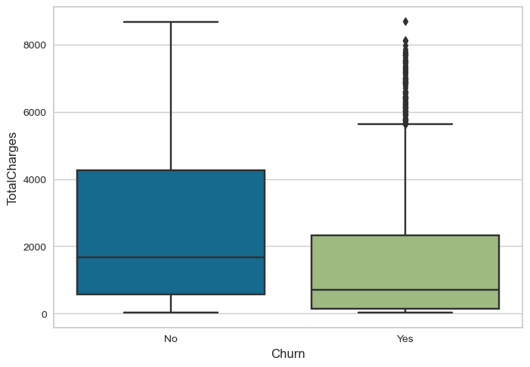
UNIVARIATE ANALYSIS OF TOTALCHARGES

Slide 27
UNIVARIATE ANALYSIS OF TOTALCHARGES

Slide 28
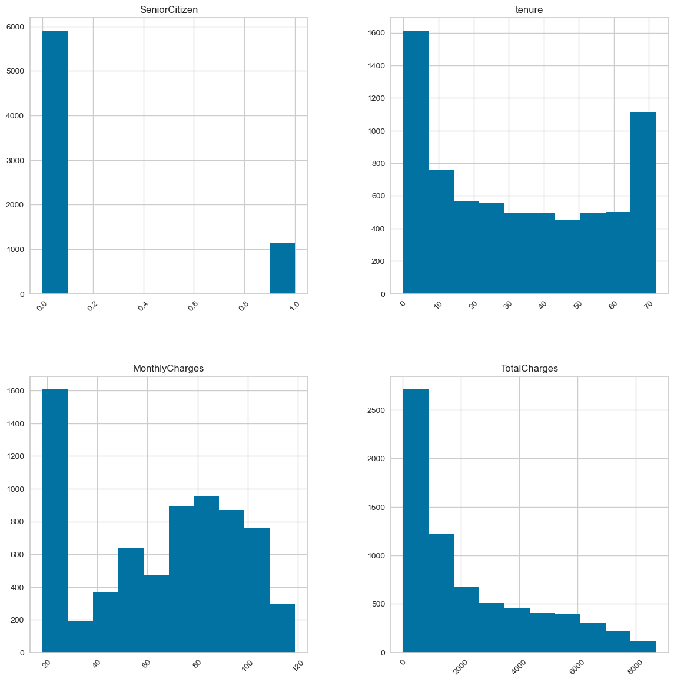
UNIVARIATE ANALYSIS OF TOTALCHARGES

Slide 29
UNIVARIATE ANALYSIS FOR NUMERICAL DATA
TENURE
For Customers Who Churned:
The median at 10 indicates that half of the churned customers have a tenure of 10 months or less.
The lower around 1, represents the 25th percentile of tenure values.
Outliers, starting from around 69 months and extending upwards, suggest that there are some customers who churned with exceptionally long tenures.
For Customers Who Didn't Churn:
Approximately, around 61 which represents the 75th percentile of tenure values.
The median at around 38 indicates that half of the customers who didn't churn have a tenure of 38 months or less.
There are no outliers visible for customers who didn't churn, indicating that their tenures are within a relatively tight range.
Also, the presence of outliers among customers who churned suggests that there are some individuals with unusually long tenures who still chose to churn.

Slide 30
UNIVARIATE ANALYSIS FOR NUMERICAL DATA
MONTHLY CHARGES
Customers who churned generally have a higher median monthly charge (around 80) compared to those who didn't churn (around 62).
Monthly charges for churned customers tend to have a wider spread (larger IQR) than for non-churned customers.
There are high-value outliers among both churned and non-churned customers, indicating that some individuals, regardless of churn status, have exceptionally high monthly charges.
SENIOR CITIZENS
The dataset consists predominantly of not Senior Citizens, accounting for the majority of customers. On the other hand, senior citizens represent a smaller but still significant portion of the customer base.

Slide 31
UNIVARIATE ANALYSIS FOR NUMERICAL DATA
TOTAL CHARGES
For customers who churned (Churn = Yes), the distribution is positively skewed, with the majority of values concentrated in the lower range. The median indicates that 50% of these customers had a total charge of around 500 or less. However, there are outliers, represented as individual data points, with very high total charges, extending beyond 8,000.
In contrast, for customers who didn't churn (Churn = No), the distribution is more spread out and has a higher median of around 1,800. The majority of these customers have total charges that fall between 150 and 4,150, with no outliers.
This suggests that customers who churned tend to have lower total charges on average compared to those who didn't churn.

Slide 32
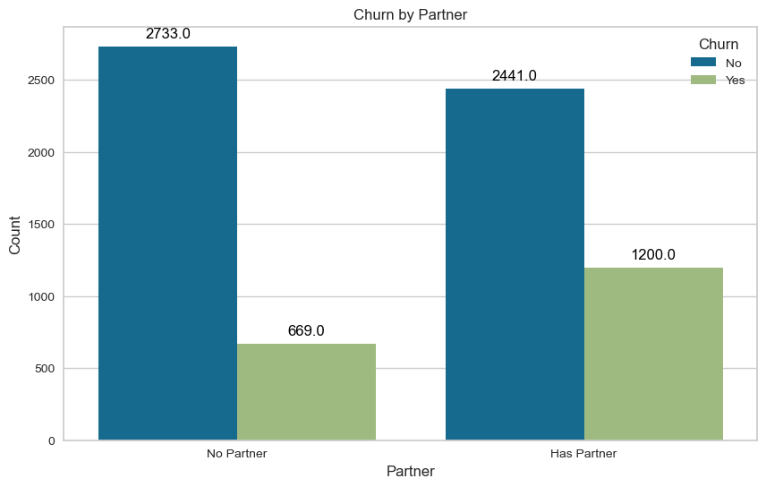
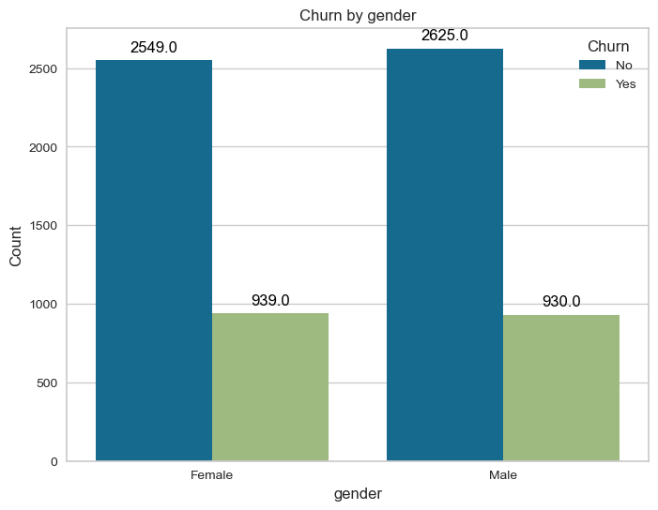
BIVARATE ANALYSIS

Slide 33
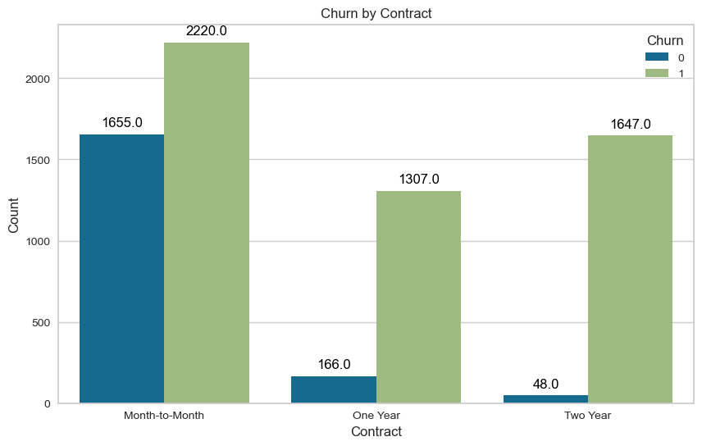
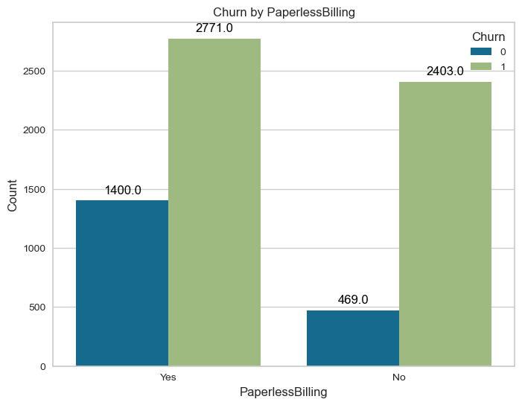
BIVARATE ANALYSIS

Slide 34
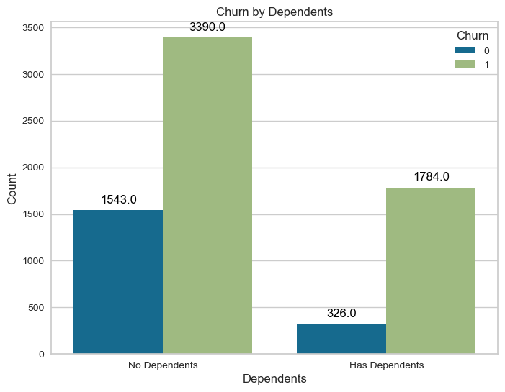
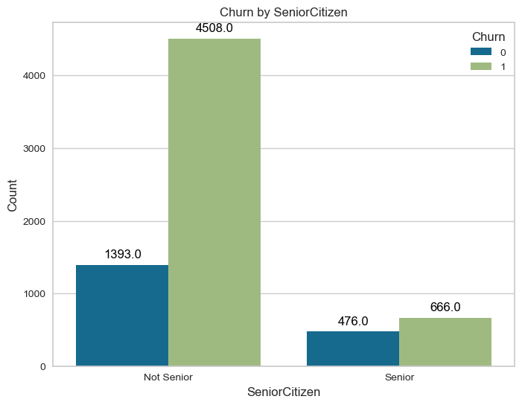
BIVARATE ANALYSIS

Slide 35
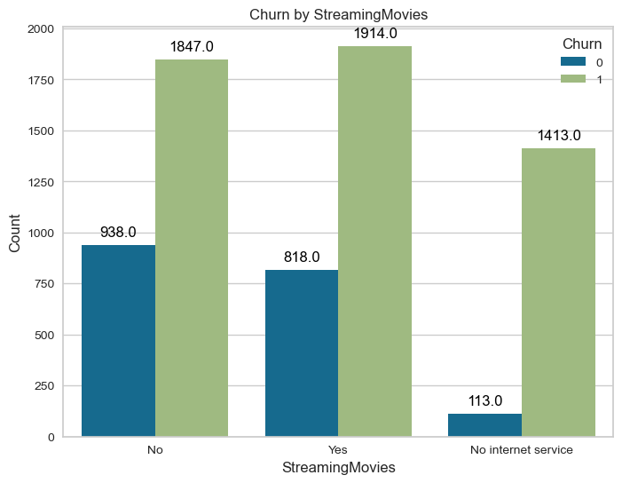
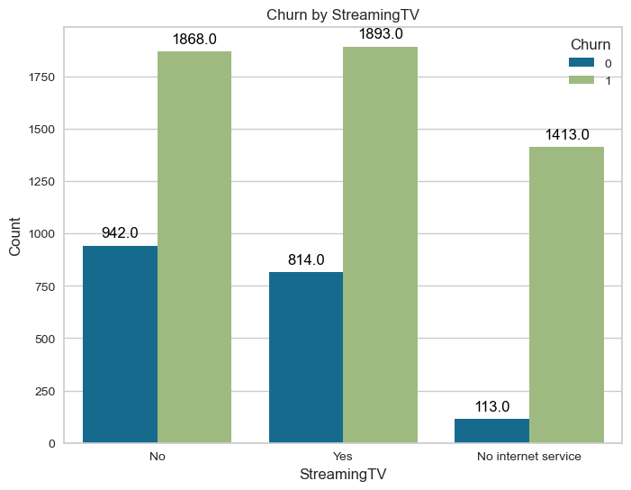
BIVARATE ANALYSIS

Slide 36
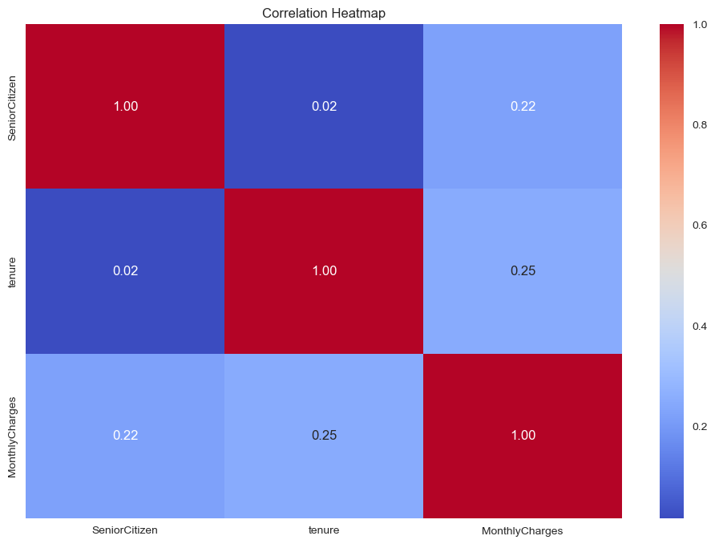
MULTIVARIATE ANALYSIS

Slide 37
MULTIVARIATE ANALYSIS
SeniorCitizen and tenure: The correlation coefficient between "SeniorCitizen" and "tenure" is approximately 0.0166. This value is very close to zero, indicating a very weak positive linear relationship between being a senior citizen and the tenure of a customer. In other words, there isn't a significant correlation between being a senior citizen and how long a customer stays with ConnectTel.
SeniorCitizen and MonthlyCharges: The correlation coefficient between "SeniorCitizen" and "MonthlyCharges" is approximately 0.2202. This positive value suggests a weak positive linear relationship between being a senior citizen and the monthly charges. It means that, on average, senior citizens may have slightly higher monthly charges than non-senior citizens, but the correlation is not strong.
tenure and MonthlyCharges: The correlation coefficient between "tenure" and "MonthlyCharges" is approximately 0.2479. This positive value indicates a weak positive linear relationship between how long a customer has been with ConnectTel (tenure) and their monthly charges. In other words, customers who have been with ConnectTel for longer tend to have slightly higher monthly charges.

Slide 38
MULTIVARIATE ANALYSIS
In summary, based on these correlation coefficients, there isn't a strong linear relationship between being a senior citizen and churn. However, there is a weak positive correlation between monthly charges and being a senior citizen and between tenure and monthly charges. This suggests that, on average, senior citizens may have slightly higher monthly charges, and customers who have been with ConnectTel for longer may have slightly higher monthly charges, but these correlations are not very strong.

Slide 39
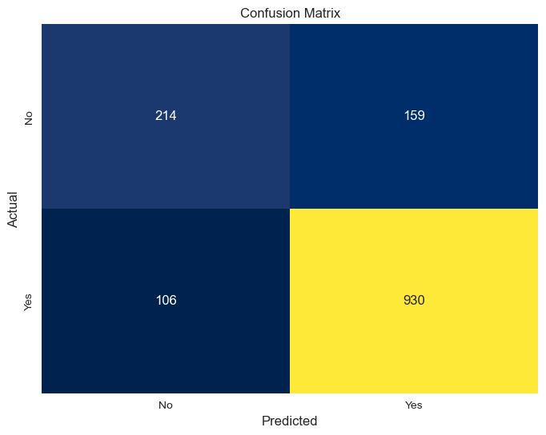
LOGISTIC REGRESSION
Accuracy: 0.8119233498935415
Precision: 0.8539944903581267
Recall: 0.8976833976833977
F1-score: 0.8752941176470589
AUC-ROC: 0.7357049696191786
Accuracy: An accuracy of 0.8119 means that approximately 81.19% of the predictions made by the model are correct.
Precision: Precision is a measure of how many of the positive predictions made by the model are correct. In this case, a precision of 0.8540 means that roughly 85.40% of the customers predicted as "churn" by the model actually churned.
Recall: A recall of 0.8977 indicates that approximately 89.77% of the customers who actually churned were correctly identified by the model..
F1-score: An F1-score of 0.8753 indicates a good balance between precision and recall.
AUC-ROC: The ROC curve is a graphical representation of a model's ability to distinguish between positive and negative classes, and the AUC (Area Under the ROC Curve) quantifies this ability. An AUC-ROC score of 0.7357 suggests that the model has some ability to discriminate between the two classes, but there is room for improvement.
Confusion Matrix: The confusion matrix shows how the model's predictions compare to the actual values:
The first row represents the actual "No Churn" class, and the second row represents the actual "Churn" class.
The first column (0) in both rows represents the predicted instances for the "No Churn" class, while the second column (373) in both rows represents the predicted instances for the "Churn" class.
In otherworld's,
True Positives (TP): The model correctly predicted "Yes" churn 930 times.
True Negatives (TN): The model correctly predicted "No" churn 214 times.
False Positives (FP): The model incorrectly predicted "Yes" churn 159 times.
False Negatives (FN): The model incorrectly predicted "No" churn 106 times.

Slide 40
DECISION TREEE
Accuracy: 0.7374024130589071
Precision: 0.8226744186046512
Recall: 0.8194980694980695
F1-score: 0.8210831721470019
AUC-ROC: 0.6644407237570776
Accuracy: An accuracy of 0.7374 means that the model correctly classifies approximately 73.74% of the instances in the dataset.
Precision: A precision of 0.8227 means that, out of all the instances the model predicted as positive, about 82.27% of them are true positives. It indicates that the model has a relatively low rate of false positives.
Recall: A recall of 0.8195 means that the model correctly identifies approximately 81.95% of all actual positive instances.
F1-score: An F1-score of 0.8211 suggests a good balance between precision and recall.
AUC-ROC: An AUC-ROC of 0.6644 suggests that the model has a moderate level of discrimination capacity.
Confusion matrix:
First Row: The first row of the confusion matrix typically represents the actual negative class (e.g., "No" or "0" in binary classification).
The first element (190) represents the number of true negatives (TN). These are instances correctly predicted as the negative class.
The second element (183) represents the number of false positives (FP). These are instances incorrectly predicted as the positive class when they are actually negative.
Second Row: The second row represents the actual positive class (e.g., "Yes" or "1" in binary classification).
The first element (187) represents the number of false negatives (FN). These are instances incorrectly predicted as the negative class when they are actually positive.
The second element (849) represents the number of true positives (TP). These are instances correctly predicted as the positive class.
In summary, the Decision Tree classifier has reasonable performance with good precision, recall, and F1-score, suggesting that it performs well at classifying the positive class. However, the AUC-ROC indicates only a moderate level of discrimination ability.

Slide 41
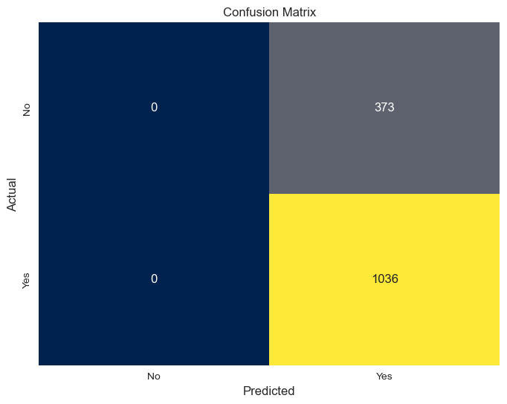
SUPPORT VECTOR MACHINE
Accuracy: 0.7352732434350603
Precision: 0.7352732434350603
Recall: 1.0
F1-score: 0.847443762781186
AUC-ROC: 0.5
Accuracy: 0.7352732434350603This represents the overall accuracy of the model, which is the ratio of correctly predicted instances to the total number of instances.
Precision: The precision is approximately 73.33%. Precision is a measure of the model's ability to correctly predict "Yes" churn when it makes a positive prediction. In this case, about 73.33% of the positive predictions ("Yes" churn) are correct.
Recall: The recall is approximately 100%. Recall measures the model's ability to correctly identify all actual "Yes" churn instances. However, this high recall comes at the cost of precision, which is lower.
F1-score: The F1-score is approximately 84.62%.
AUC-ROC: The area under the ROC curve (AUC-ROC) is approximately 0.5.
Overall, the SVM model has a high recall, meaning it is good at identifying actual "Yes" churn instances, but the precision is relatively low, indicating a significant number of false positives. The AUC-ROC of 0.5 suggests that the model's ability to discriminate between classes is not better than random guessing.

Slide 42
SUPPORT VECTOR MACHINE
The first row represents the actual "No Churn" class, and the second row represents the actual "Churn" class.
The first column (0) in both rows represents the predicted instances for the "No Churn" class, while the second column (373) in the first row and the second column (1036) in the second row represent the predicted instances for the "Churn" class.
In otherwords,
True Negatives (TN) are 0, indicating that the model did not correctly classify any instances as "No Churn."
True Positives (TP) are also 0, indicating that the model did not correctly classify any instances as "Churn."
False Negatives (FN) are 373, indicating that 373 instances were falsely predicted as "No Churn."
False Positives (FP) are 1036, indicating that 1036 instances were falsely predicted as "Churn."
In summary,
Overall, these results suggest that the SVM model is not effectively distinguishing between the classes, and the AUC-ROC score indicates that the model's performance is no better than random guessing.

Slide 43

RANDOM FOREST
Accuracy: 0.7863733144073811
Precision: 0.8266666666666667
Recall: 0.8976833976833977
F1-score: 0.8607126330402591
AUC-ROC: 0.6874475969650231
Accuracy: The model has an accuracy of approximately 78.64%.
Recall: In this case, it's approximately 89.77%, indicating that the model can recall a large proportion of the actual positive instances.
Precision: Its approximately 82.67%, indicating that most of the positive predictions are correct.
F1-score: An F1-score of approximately 86.07% indicates a good balance between precision and recall.
AUC-ROC: The AUC-ROC score is approximately 0.687, which suggests that the model's ability to distinguish between positive and negative instances is better than random chance but may not be highly effective. It indicates a moderate ability to separate the classes.
In this confusion matrix:
True Negatives (TN) are 178, indicating that 178 instances were correctly classified as "No Churn."
True Positives (TP) are 930, indicating that 930 instances were correctly classified as "Churn."
False Negatives (FN) are 106, indicating that 106 instances were falsely predicted as "No Churn" when they were actually "Churn."
False Positives (FP) are 195, indicating that 195 instances were falsely predicted as "Churn" when they were actually "No Churn."
Overall, these results suggest that the Random Forest model performs relatively well in terms of accuracy, precision, recall, and F1-score. It shows a better ability to separate classes compared to the SVM model (as indicated by a higher AUC-ROC score).

Slide 44
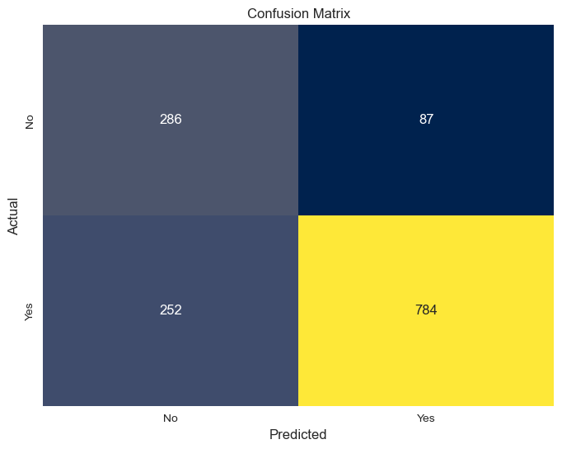
NAÏVE BAYES CLASSIFIER
Second Row: The second row represents the actual positive class (e.g., "Yes" or "1" in binary classification).
The first element (252) represents the number of false negatives (FN). These are instances incorrectly predicted as the negative class when they are actually positive.
The second element (784) represents the number of true positives (TP). These are instances correctly predicted as the positive class.
In summary, the Naive Bayes classifier has relatively good precision, recall, and F1-score, suggesting that it performs reasonably well at classifying the positive class. However, the AUC-ROC indicates only moderate discrimination ability.
Accuracy: 0.759403832505323
Precision: 0.9001148105625718
Recall: 0.7567567567567568
F1-score: 0.8222338751966439
AUC-ROC: 0.7617563944641693
Accuracy: This indicates that the model correctly predicts approximately 75.94% of the instances in the test set.
Precision: In this case, it's about 90.01%, which means that when the model predicts "Churn," it is correct approximately 90.01% of the time.
Recall: It's about 75.68%, indicating that the model captures a significant portion of the actual "Churn" cases.
F1-score: An F1-score of approximately 82.22% suggests a good balance between precision and recall.
AUC-ROC: A score of 0.7618 suggests that the model's ability to separate the classes is better than random guessing, although there may be further room for improvement.
First Row: The first row of the confusion matrix typically represents the actual negative class (e.g., "No" or "0" in binary classification).
The first element (286) represents the number of true negatives (TN). These are instances correctly predicted as the negative class.
The second element (87) represents the number of false positives (FP). These are instances incorrectly predicted as the positive class when they are actually negative.

